Slide 1
WORK SAMPLE - ANALYZING ATTRITION
Ann Xiao
Yifeng Wang
02.19.2019

Slide 2

EXECUTIVE SUMMARY
This analysis portraits the commonalities of employees who have left the company in the past year. The determinants of attrition were explored, followed by proposals in action plan and next steps.
Who are most likely to leave:
- Millennials and Gen X who have mid-to-high level of education;
- Generally worked for more companies comparing to their peers and have stayed in the company for shorter time period;
- Ranked lower in job levels, earn less, and have less stock options although their performance may be satisfactory;
- They are likely to leave during their 1st year at the company, between 5-7 years of total working years, and less likely so after year 10;
- Have lower income, though not necessarily have worse performance;
- Prefer less overtime, and are less satisfied in work-life balance, work environment, job involvement, and training opportunities;
- Also tend to have more have more flexible skill sets from educational field

Slide 3
REASEARCH METHODOLOGY
Data Exploration Analysis
What Happened？
01
Hypothesis Verification
Is It True and Why Did it Happen?
02
Next Steps & Action Plan
What Should We Do About It?
03

Slide 4

1. Data Exploration

Slide 5
DATA OVERVIEW
Personal Descriptive Info
Education Field
Age
Total Working Years
Etc.
Total Compensation
(both monetary and intangible)
Monthly Income
Stock Options
Job Level
Training times Last Year
Etc.
Employee Satisfaction
Work-life balance
Travel Intensity
Job Satisfaction
Environment Satisfaction
Relationship Satisfaction
Job Involvement
Etc.
The dataset is 100% populated with 1470 records, attrition info (Yes/No), and 34 variables. After cleaning, it’s ready for visualization.
The important variables possibly containing explanatory and predictive info for attrition can be categorized into 3 main buckets:

Slide 6
For last year, the company’s attrition rate is 16.1%, which is 2% higher than last year.
Attrition is defined as leaving the company altogether. It does not include transfers to other departments or cost centers.
ATTRITION
Hypothesis Verification
Next Steps

Slide 7
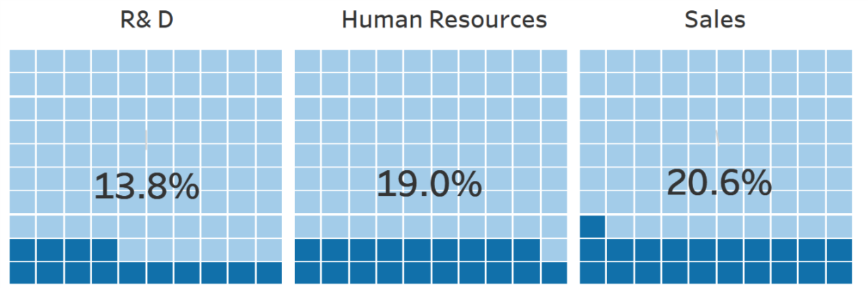
What are the attrition rate by department?
Sales is the department with the highest attrition.

Slide 8
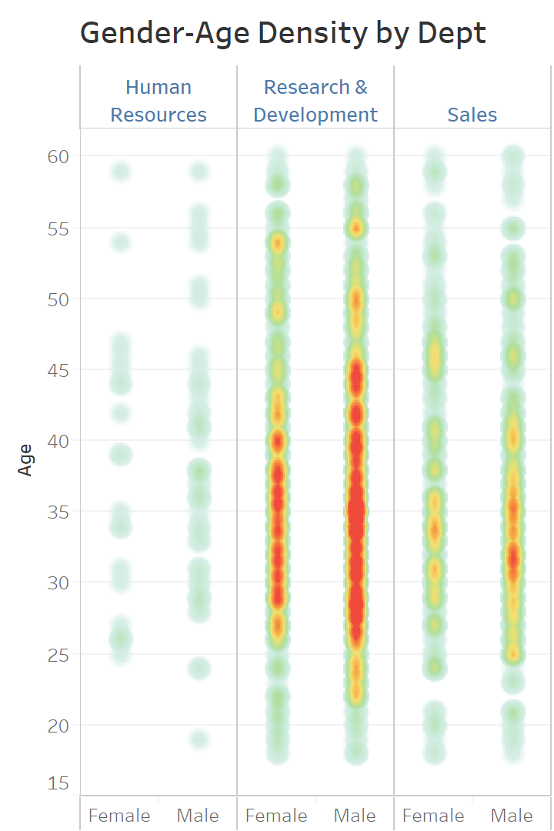
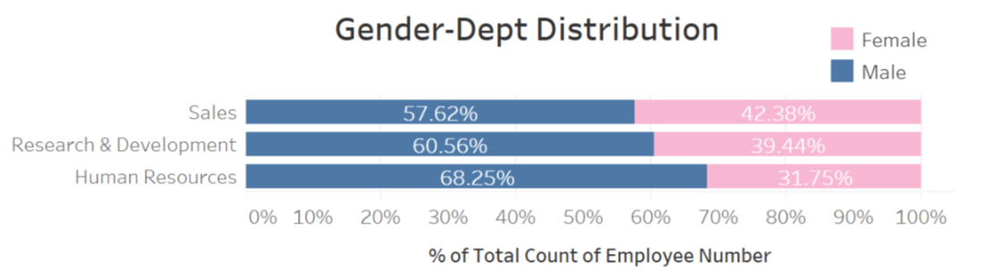
Gender distribution is relatively in reasonable scale, hypothetically attrition is not caused by gender bias.
The density plot shows where the concentration of demographic distribution in both gender and age. The darker area shows it’s most densely concentrated between around 27 – 46 in R&D and relatively evenly distributed among gender.
Sales is the department with the highest attrition.

Slide 9
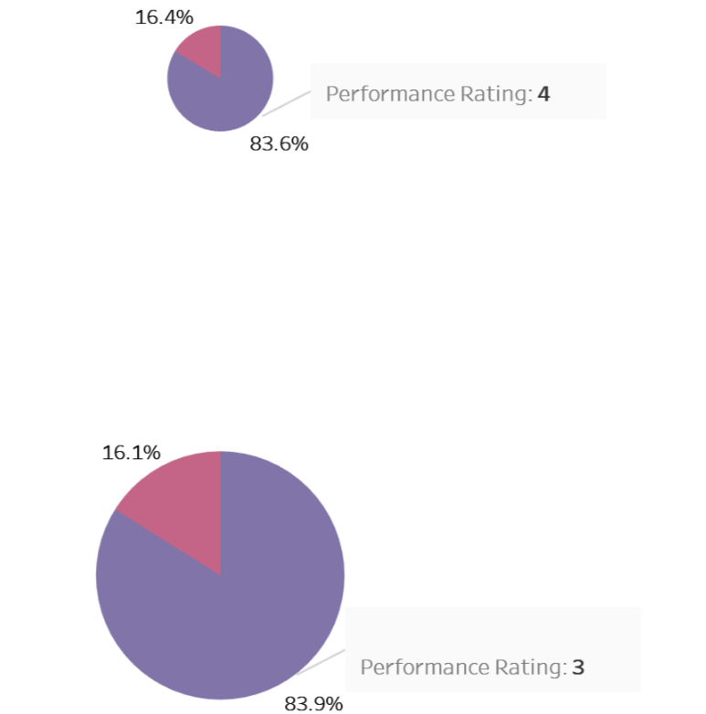
So who left the company?
Performance in Relation to Attrition
Fortunately, we also didn’t lose our high performers disproportionately.

Slide 10
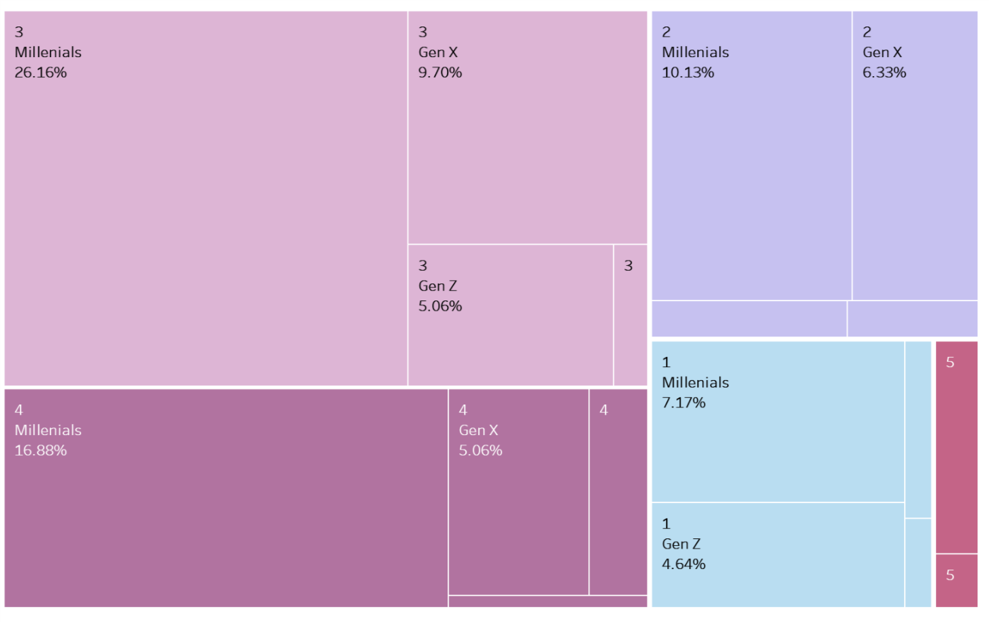
From this chart we can see that in every education level we lose more millennials, mainly followed by Gen X, especially in Education level 3&4. Generally speaking, highly-educated middle-aged workers are leaving, possibly creating a gap in workforce succession in the future.
Education Level
 | 1
 | 2
 | 3
 | 4
 | 5

Slide 11
2. Hypothesis Verification

Slide 12
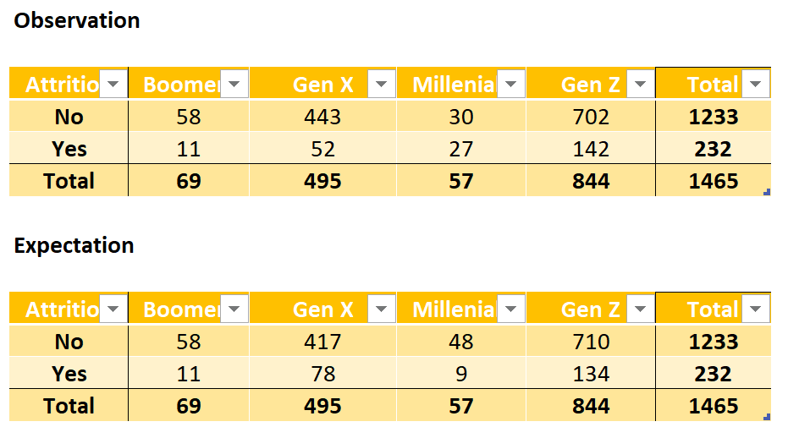
Thru Chi-square Testing, age group in Gen X and Millennials is verified to have a significantly higher attrition rate, with P-value = 3.20768E-13.
If generation is not an influencing factor, the differences wouldn’t be significant.

Slide 13
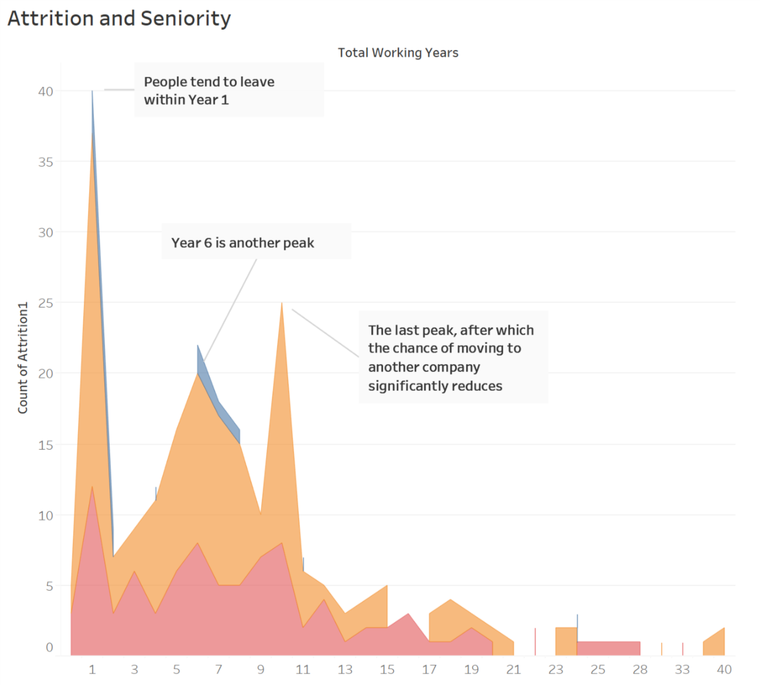
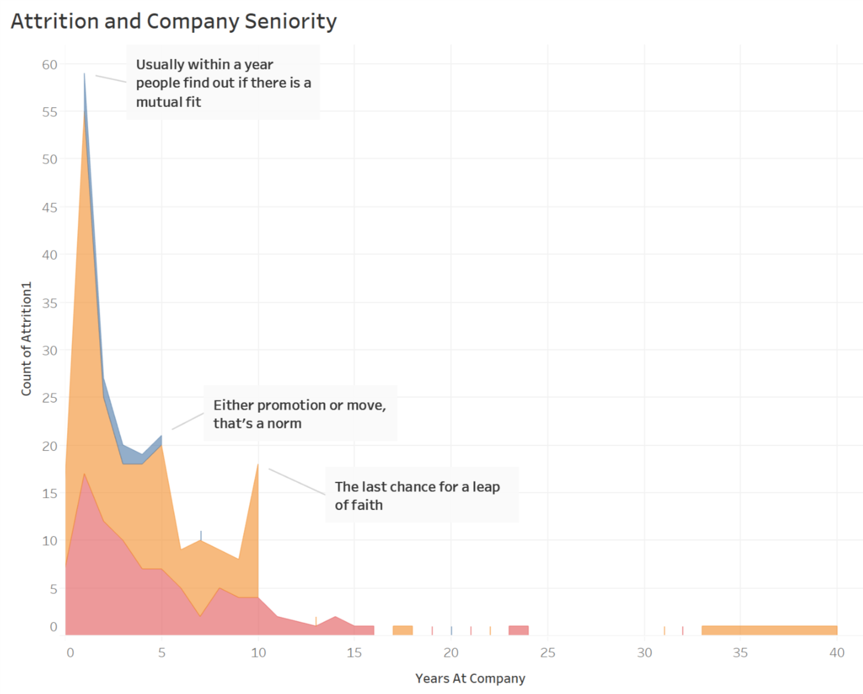
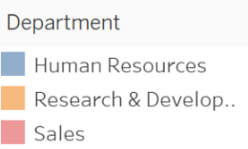
It is observed from the chart below that there are several peaks in working years and years at the company that people tend to leave, which matches our experience – people tend to leave after they find they don’t fit with the company(usually within shorter time frame), or for career development purposes after 3-5 years, and usually settle down if they stay with the company for more than 10 years.

Slide 14
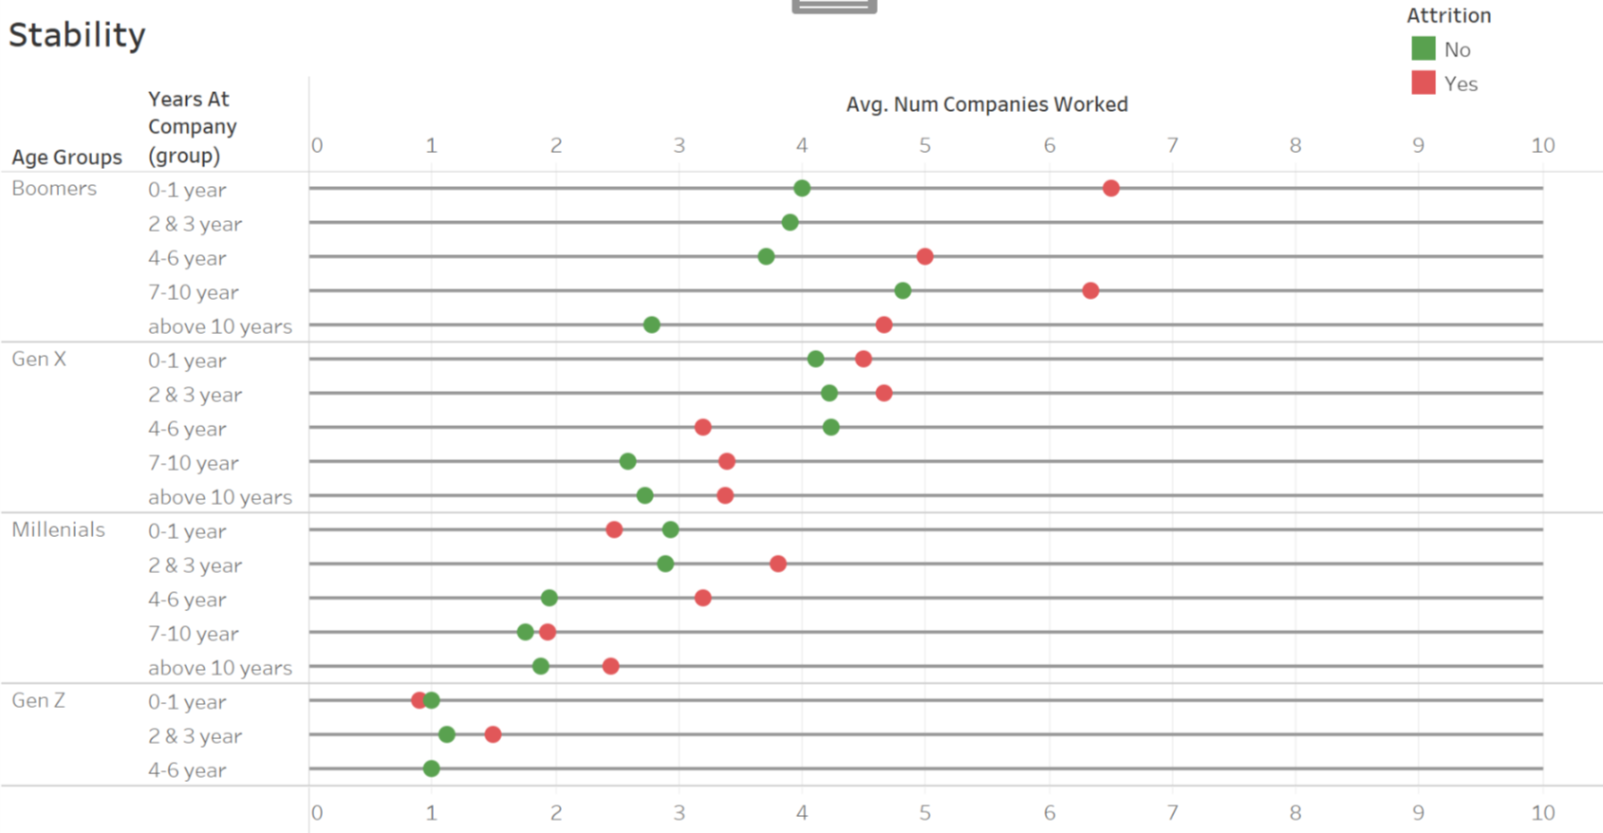
It is also observed that seniority and company seniority has a significant positive correlation with attrition, and number of companies worked for has a significant negative relation. P-values through one-tailed t-test are 1.2E-07, 1.2E-07, and 0.05 respectively.
Df;af

Slide 15
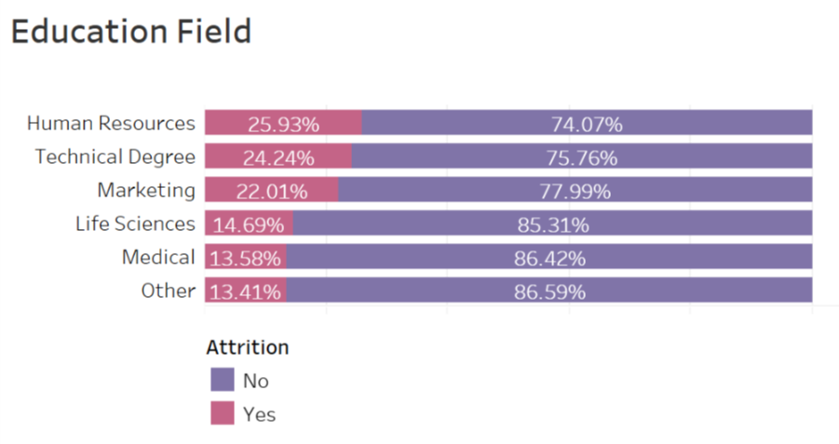
Education field also makes a difference, a possible explanation is that it could be related to external labor market demand and skill sets transferability.

Slide 16
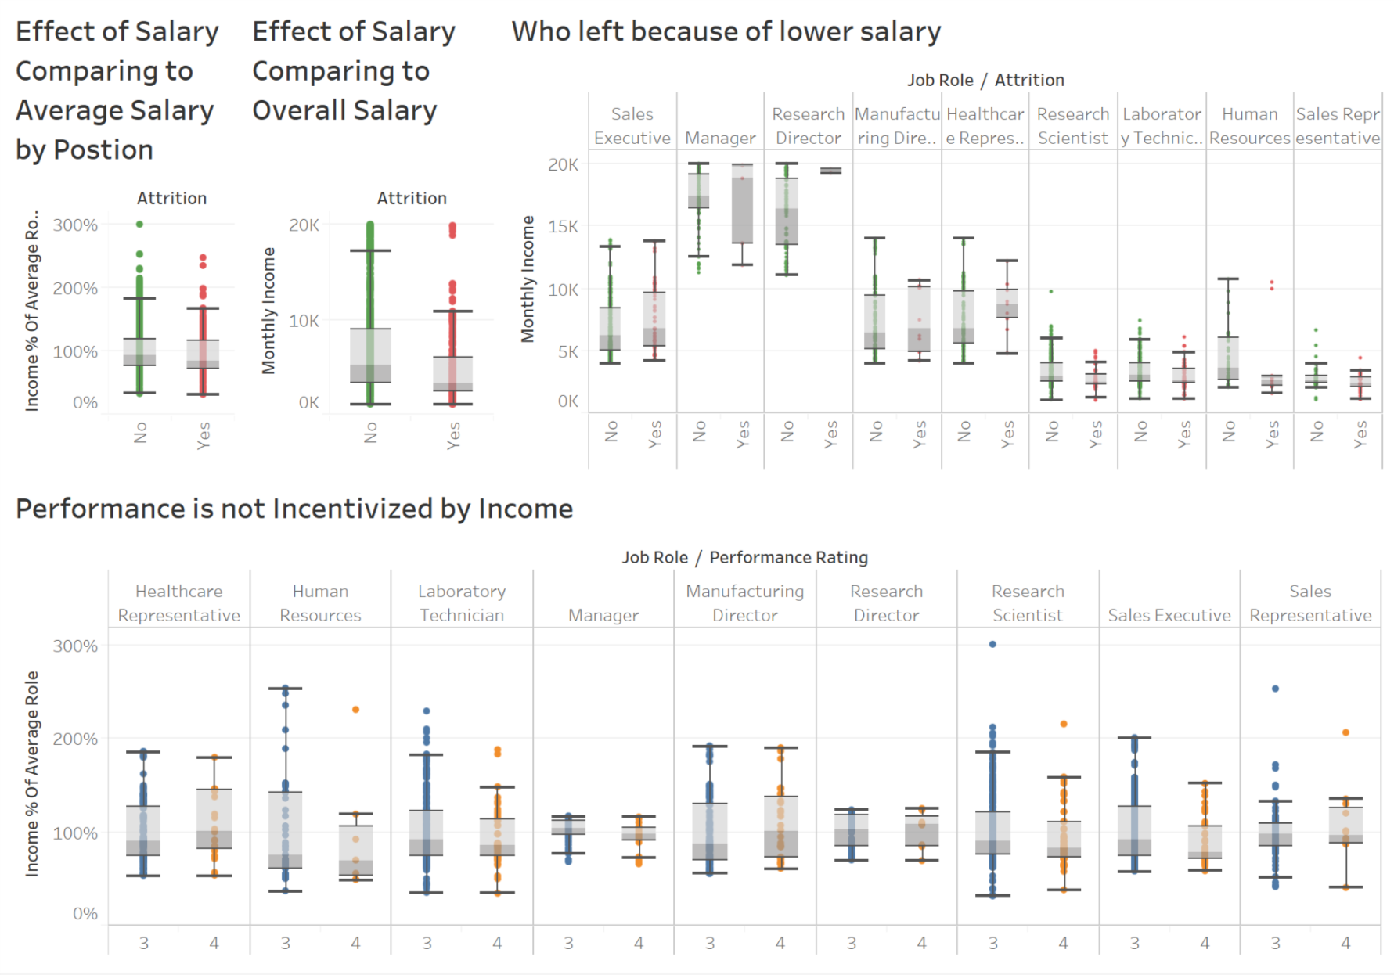
By looking at monthly income, it is observed that employees are not unhappy about their relative income level comparing to peers, but absolute income level – at an monthly income level of less than 5k, the people who left have a significant lower level of income distribution. Combining to previously examination into performance and the last graph, it shows that when people have a lower income and their performance is not incentivized by monetary rewards, they leave the company, either voluntarily or involuntarily.
Income differences exist here

Slide 17
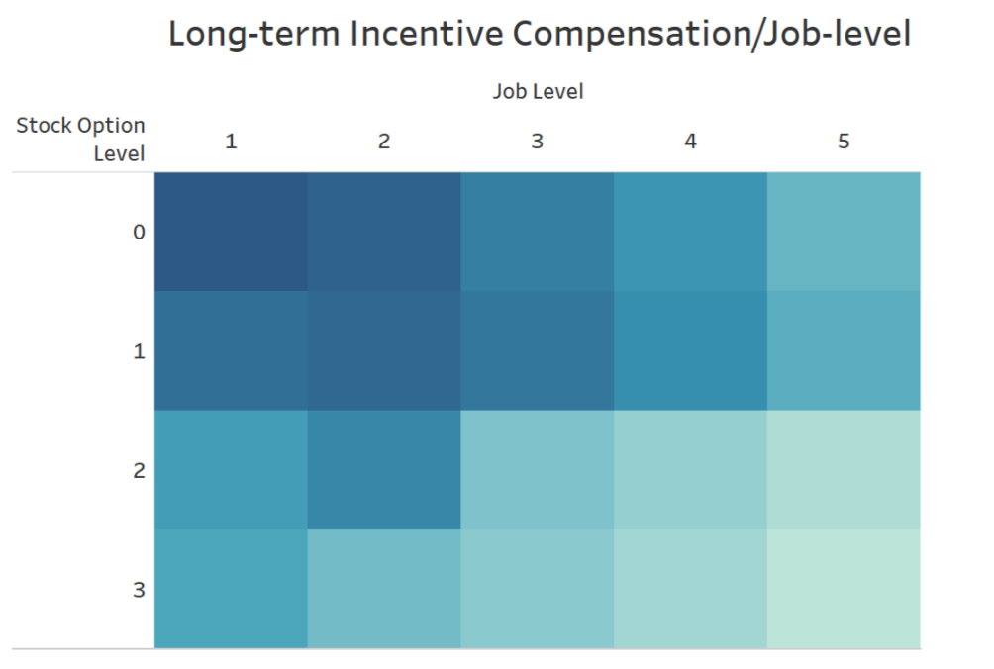
In this graph, the darker the color, the more account of attrition there is. This shows people tend to leave when they are at lower job level and not incentivized by long-term incentive. This could prove the effectiveness of long-term talent retain of stock options.

Slide 18
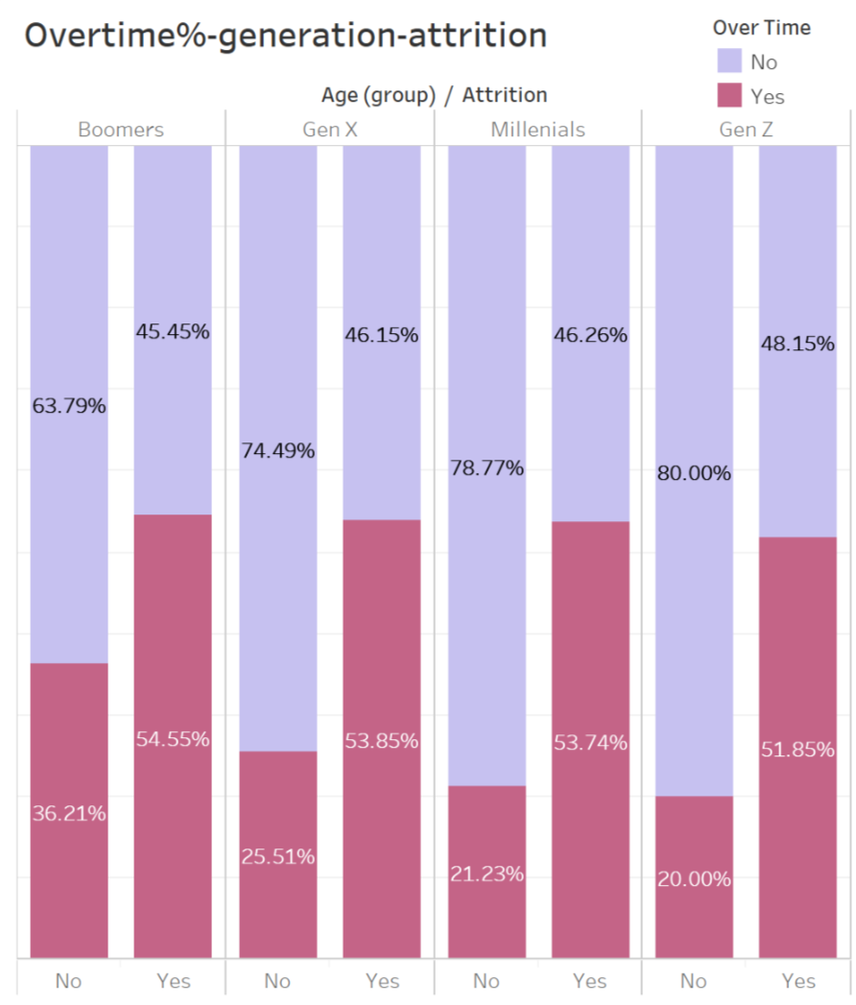
Millennials and Gen X could also place high importance on whether they need to work overtime or not.
The younger the generation, the less tolerable they are to overtime

Slide 19
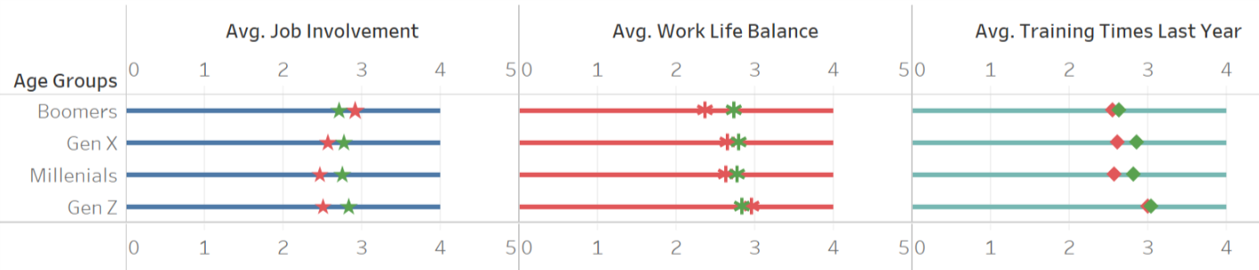
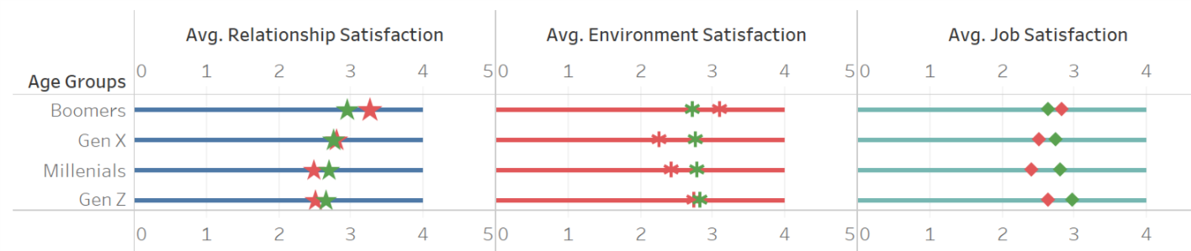
Generally the people who left have less fulfillment, happiness, and career development opportunities.
No
Attrition
Yes

Slide 20
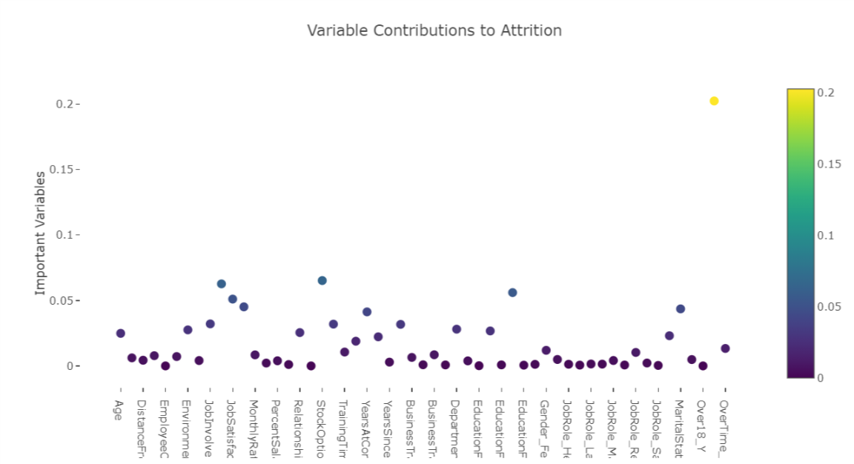
To verify the above findings and hypothesis, a machine learning model was built to both examine the most important variables contributing to attrition and also predict future attritions according to those variables. A random forest model was used here.
The model evaluates and verifies that the most contributing variable is overtime, followed by Job Satisfaction, Monthly income, Age, Stock Option, Education Field. It also provides additional insights in variables such as Marital Status and Distance from Home for further analysis.

Slide 21
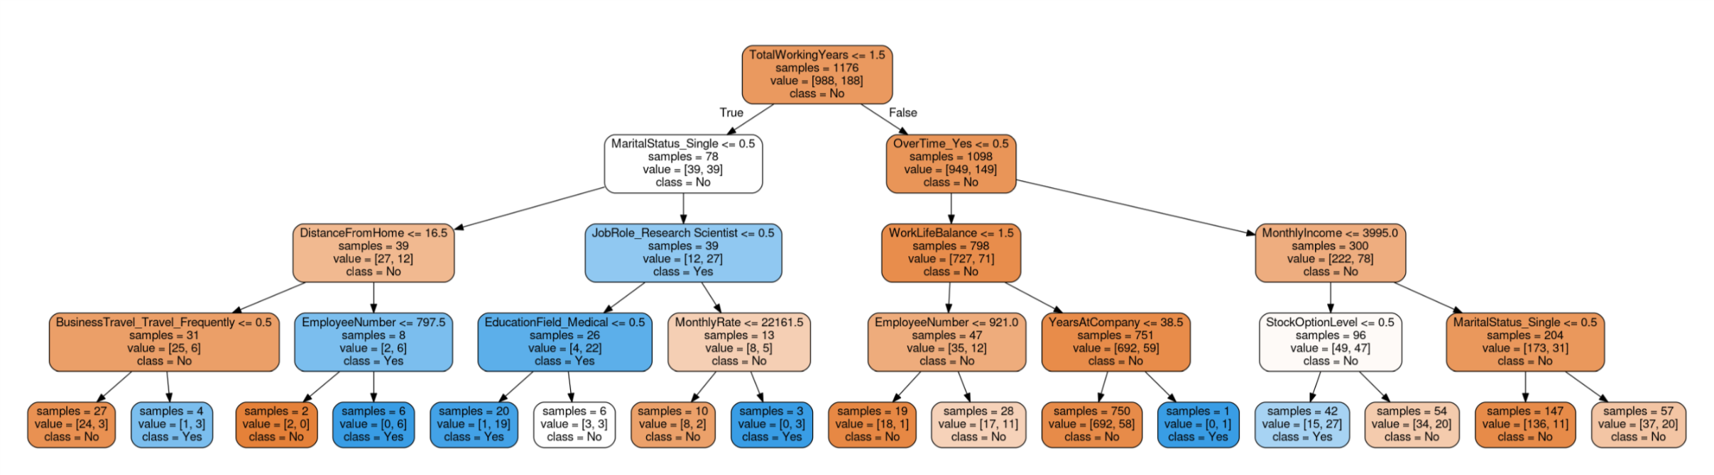
This chart give specific importance ranking and related weighting.

Slide 22
3. Next Steps & Action Plan

Slide 23

Action Plan
From above observation, hypothesis, testing and confirmation, the following are proposals for future actions:
For short term:
Predictions from the Machine Learning model can be used as input for workforce planning.
A scoring and flagging system can be built for proactive measures. Responsible HRBP can be alerted of employees above flagging score，then may conduct stay interview or take other appropriate measures accordingly.
For middle to long term:
A more systematic change management approach can be taken that incorporates considerations including performance management, compensation adjustment, promotion, and intangible benefit. Because these would have a lot of intricacies in implementation, they need to be more carefully planned, managed, and closely monitored on effectiveness.
A department with higher attrition （e.g. Sales 20.6%) may conduct pilot program first, and if effective, it can be extended to other departments.

Slide 24

Next Steps
For the next steps, the following can be considered according to resource budget and priority:
Use the quantitative result to drill down and get more qualitative information beyond numbers, e.g. stay interview, employee engagement survey with targeted questions.
Further analyze the data set in combination of data resources and other measurements, e.g. the healthiness of attrition (voluntary/involuntary), time and trend, geographic locations, manager name. Possible insights may be generated to use as input to arbitrage local team size, compete for talent with competitors, and provide managers leadership and communication trainings if needed.
Support the development of attrition scoring and flagging system.
Explore the influence of other easily overlooked forces such as causal relationship, interdependency, and Matthew Effect etc..

Slide 25

THANK YOU

Slide 26
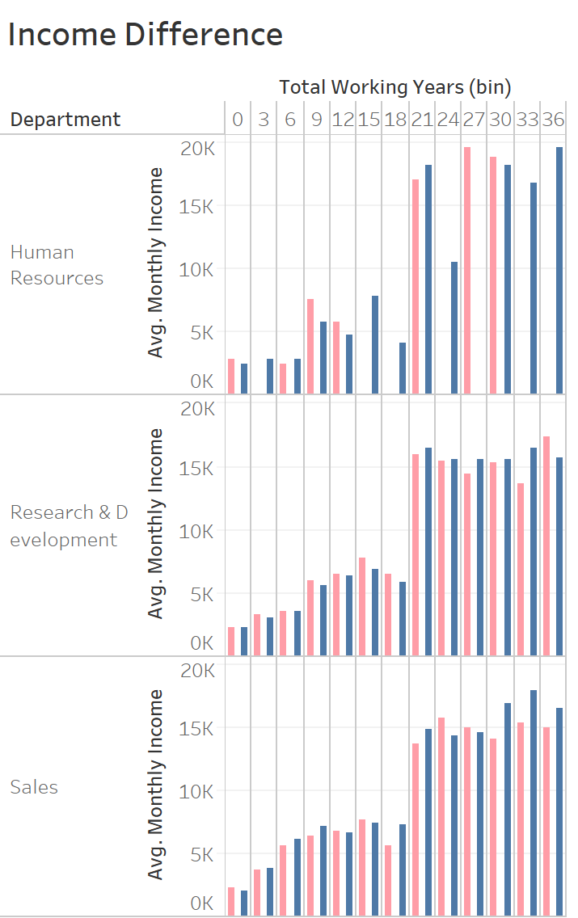
APPENDIX - other visualizations that are not the main scope of the discussion here but may may provide further insights.

Slide 27
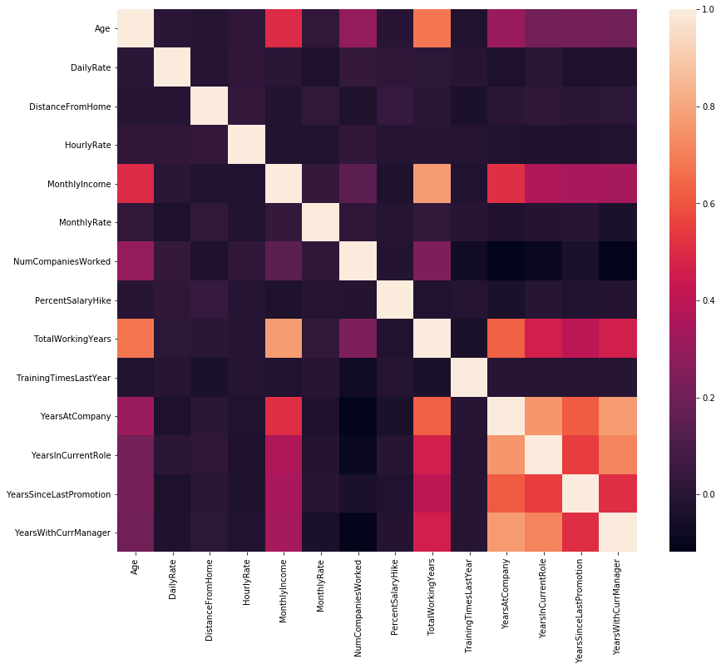
Correlation between variables

Slide 28
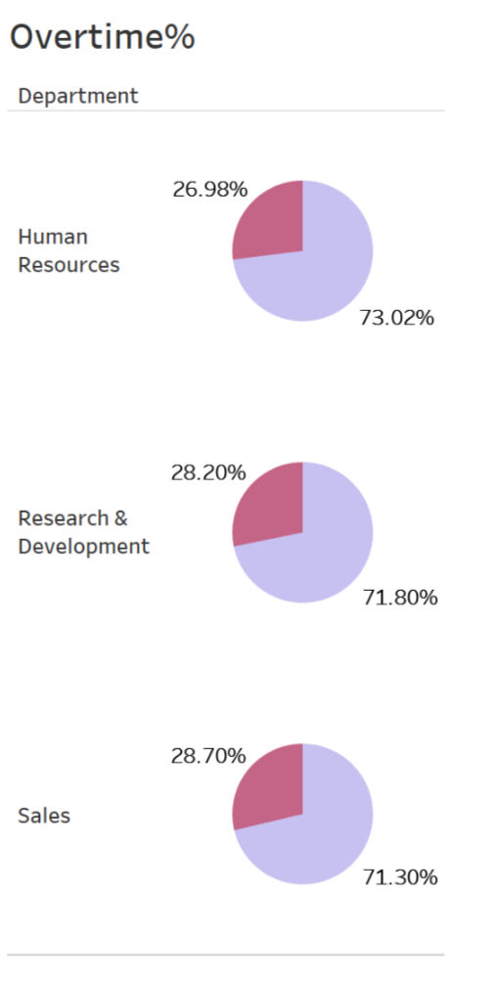

Slide 29
With chi-square, the observation is also verified that attrition is not significantly different by gender or performance, which is a good thing – again, it means attrition is not caused by gender bias, and we didn’t lose good performers.
Notes:
Center the title and explain what a good or bad result is. These people are not statisticians.

